Slide 1


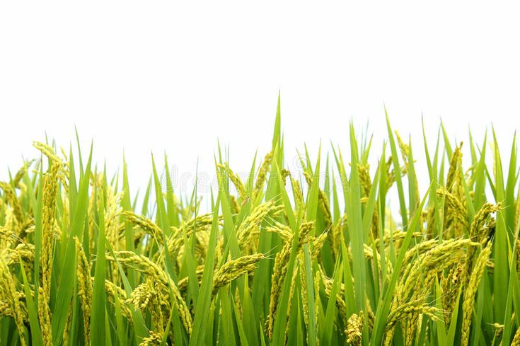
Integration Of Cellular IOT For Greenhouse Monitoring, Controlling And Notification System
Paper ID-251
Presented by
Prof. Swarna Prabha Jena
Dr. Sujata Chakravarty
Sasmita Sahoo
Mamali Sahoo
Centurion University of Technology and Management ,Odisha, India

Slide 2

INTRODUCTION
OBJECTIVE
BLOCK DIAGRAM
FLOW CHART
REAL WORLD IMPLEMENTATION
RESULTS AND DISCUSSION
SMS ON SINGLE NUMBER
SMS ON MULTIPLE NUMBER
VISUALIZATION USING THINGSPEAK
EXPORTING DATA TO CSV
CONCLUSION
FUTURE SCOPE
REFERENCES
Contents

Slide 3
Introduction
Greenhouses are like special houses for plants where we can grow them in a cozy environment. But sometimes it's hard to be there all the time to make sure everything's just right for the plants. So in this system, it uses sensors to check things like how warm or damp it is inside. These sensors talk to a central control unit that can send messages through GSM-SMS.
By using a low cost more efficient programmable module to detect the climatic behavior inside the greenhouse and controlling the parameters according to their crop production need, through various techniques with the use of board Arduino UNO, this system can be made.

Slide 4
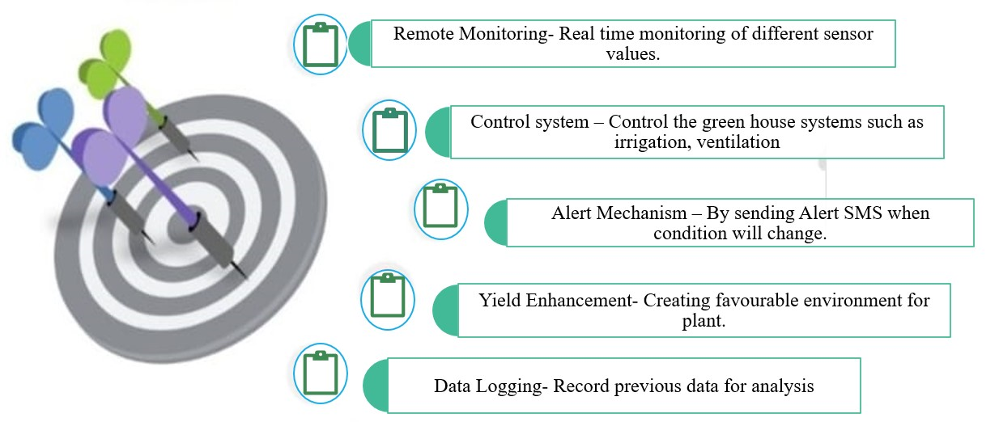
Objective

Slide 5
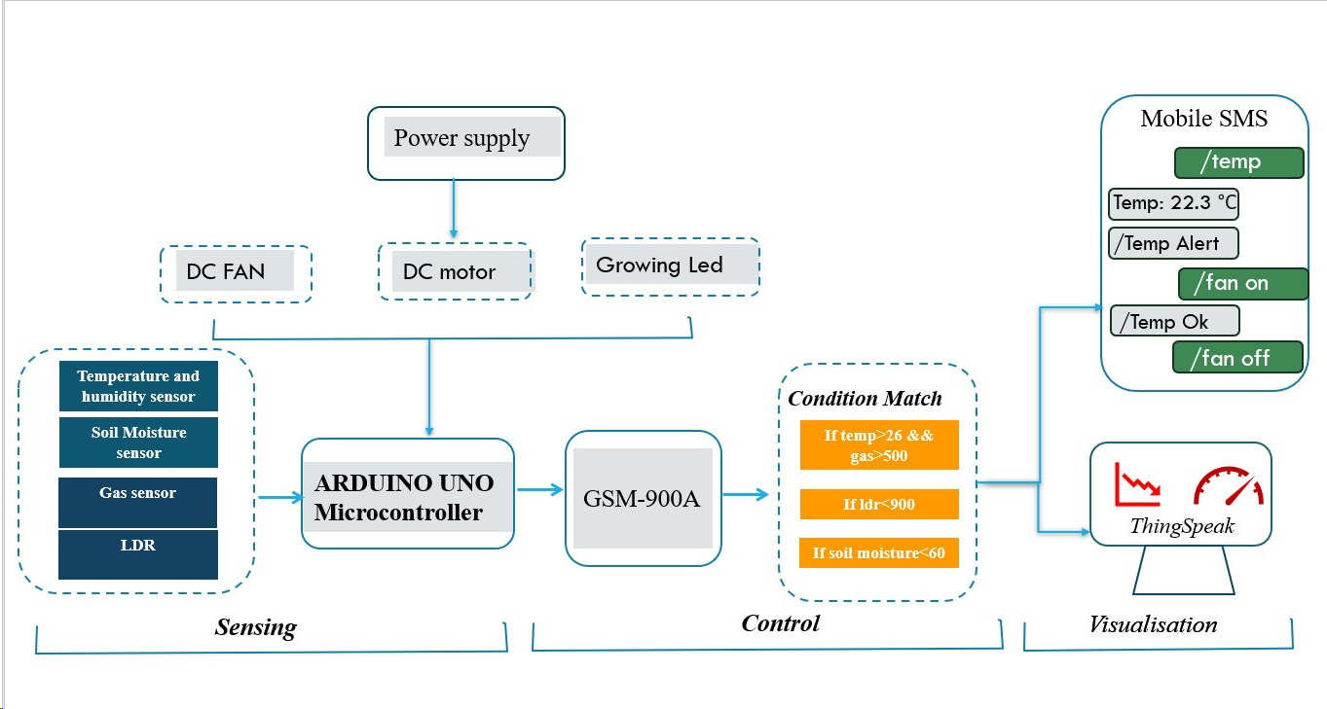
Block Diagram

Slide 6
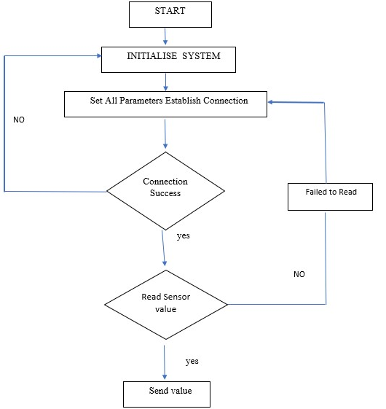
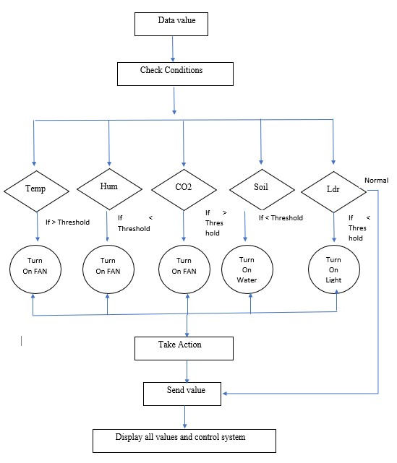
Flow Chart

Slide 7
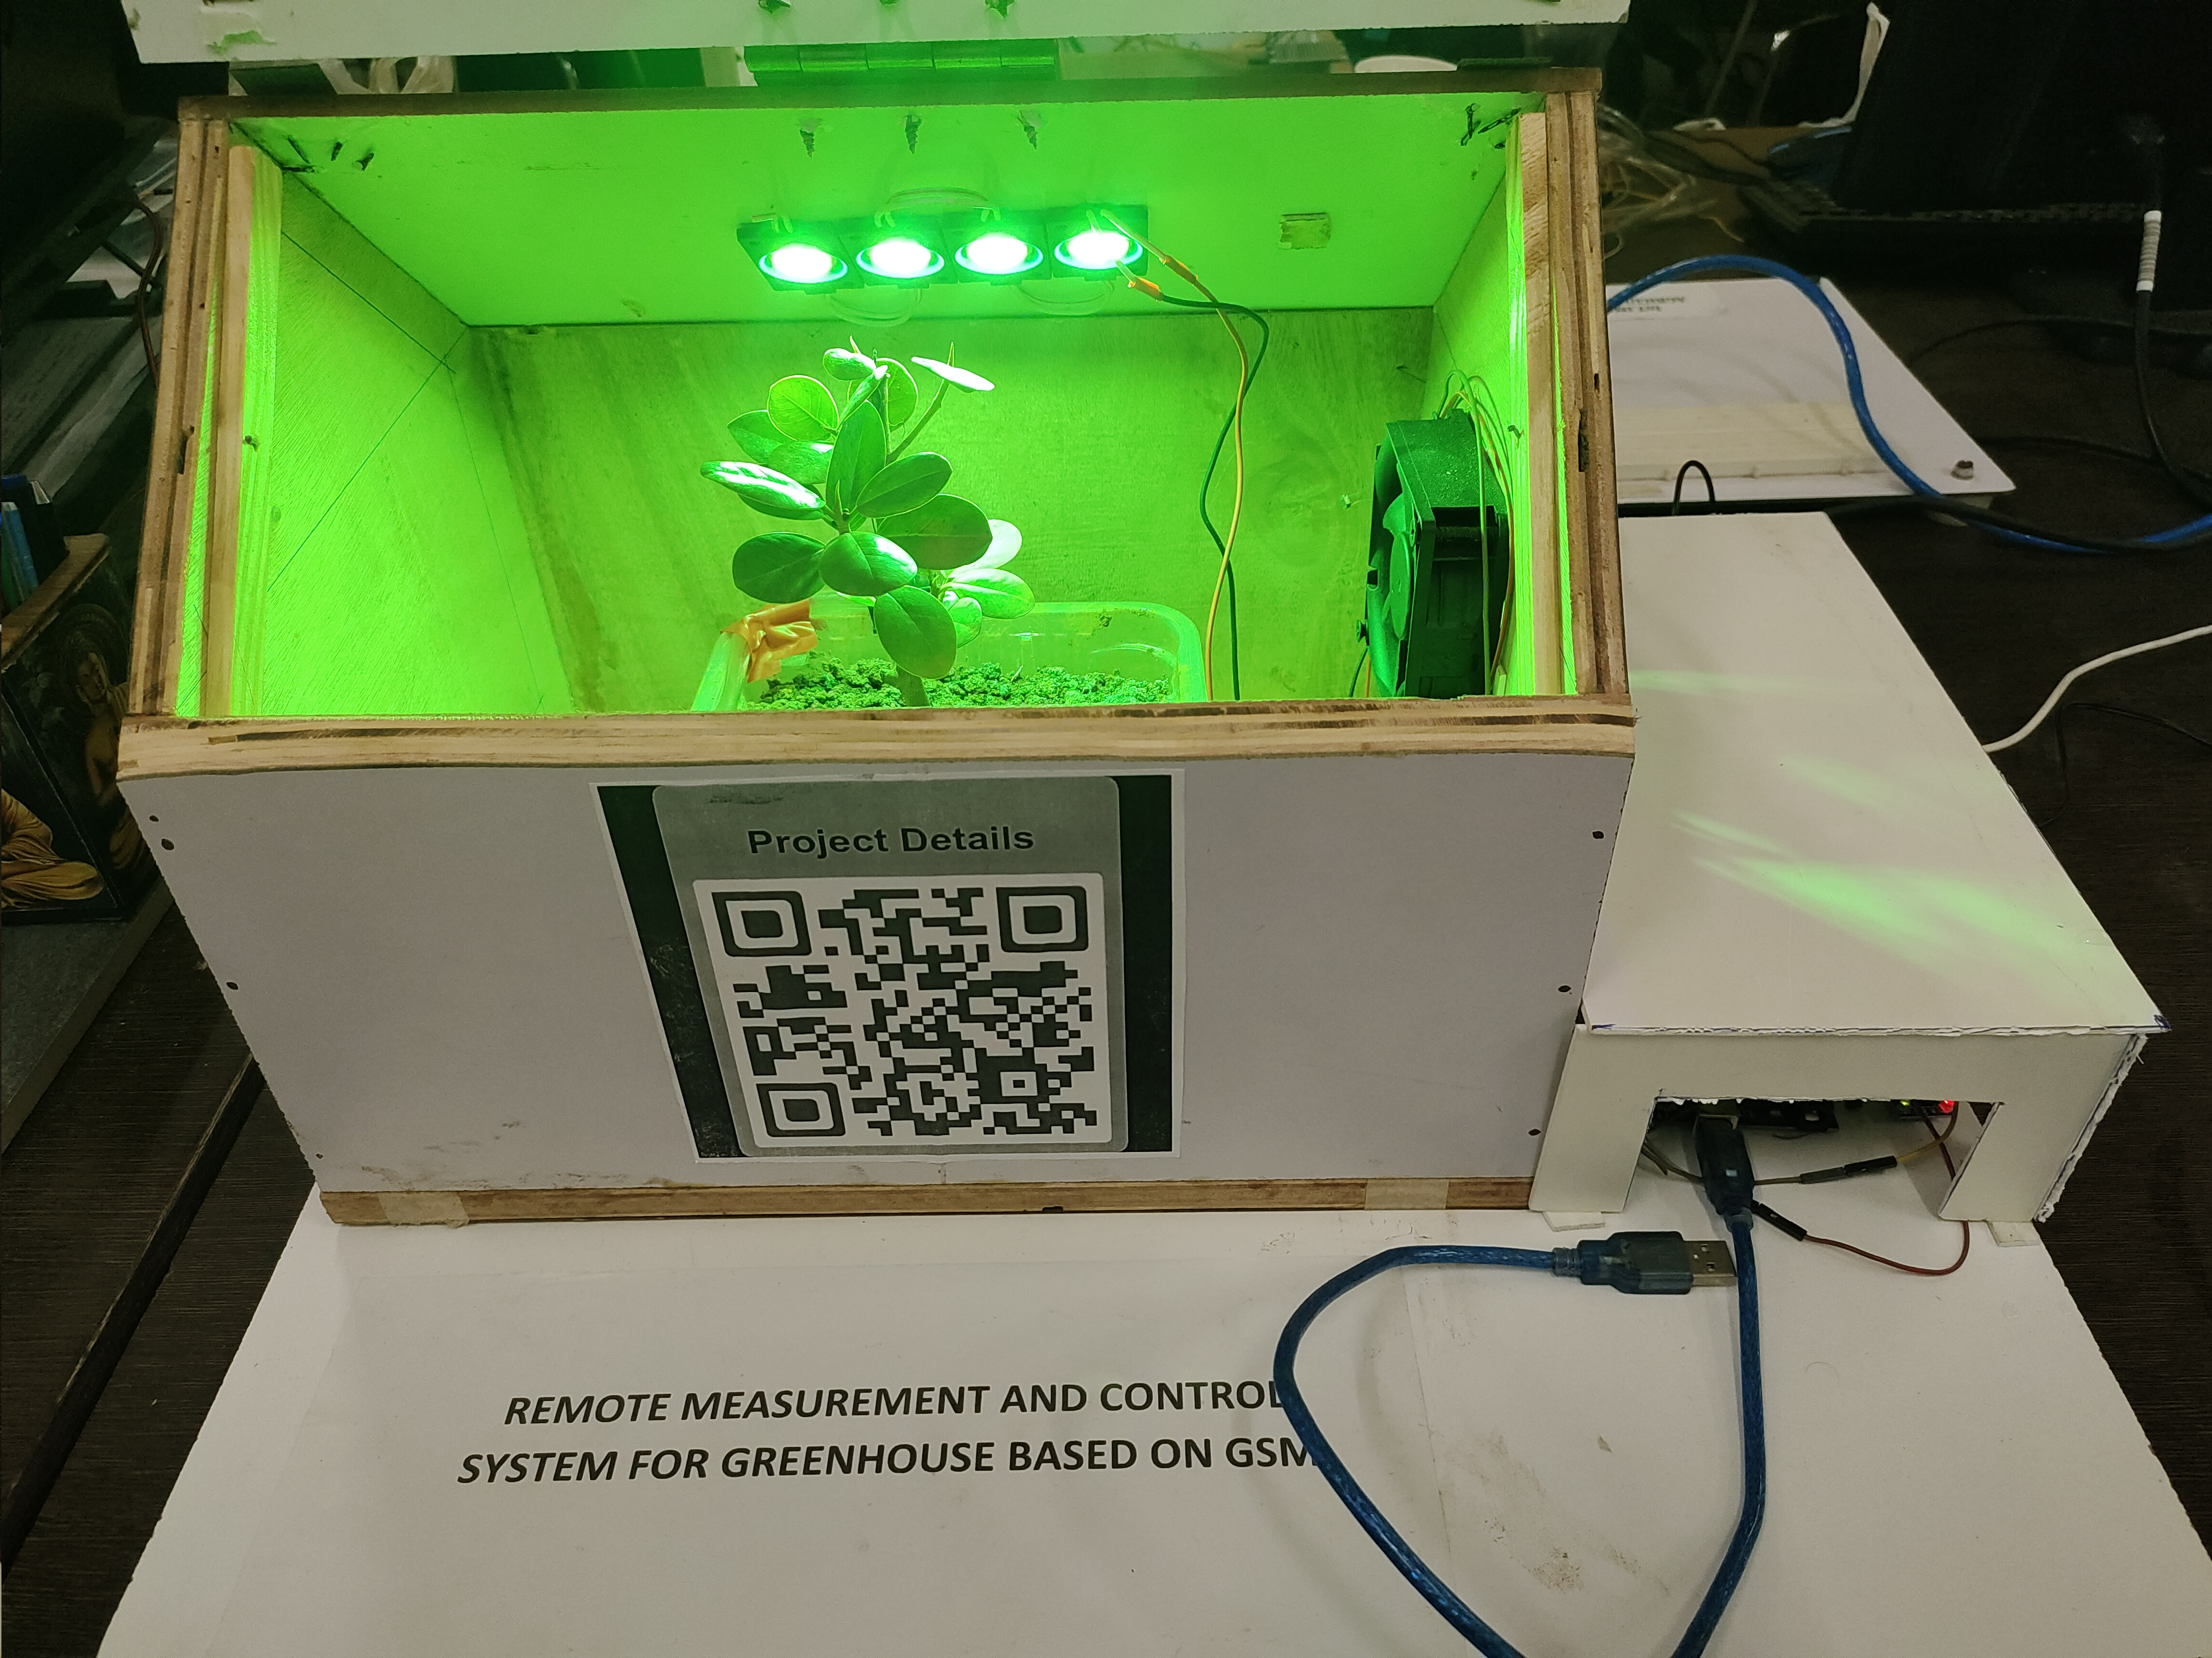
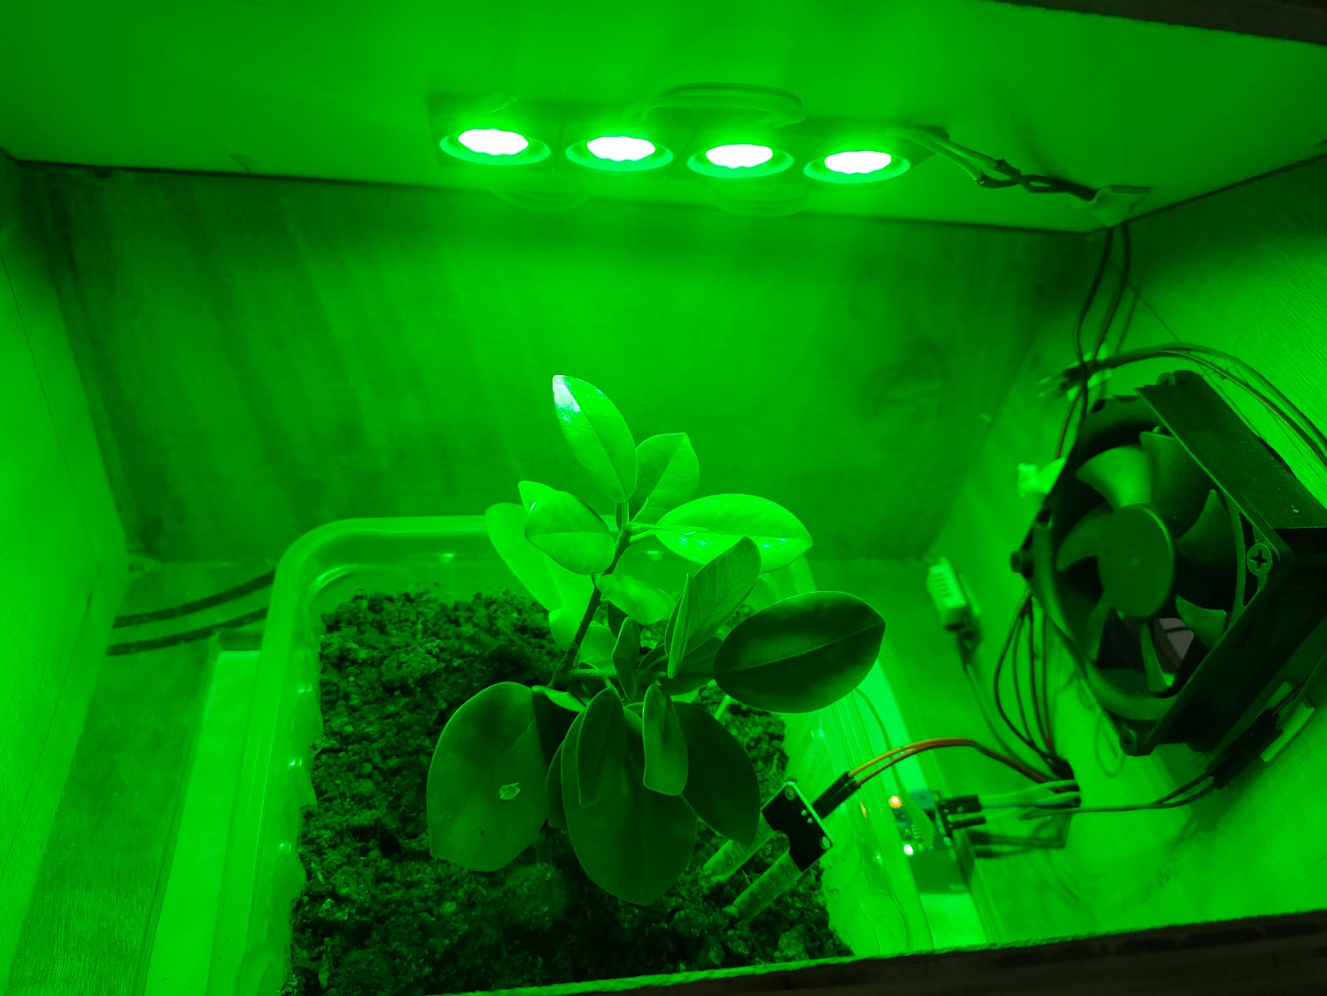
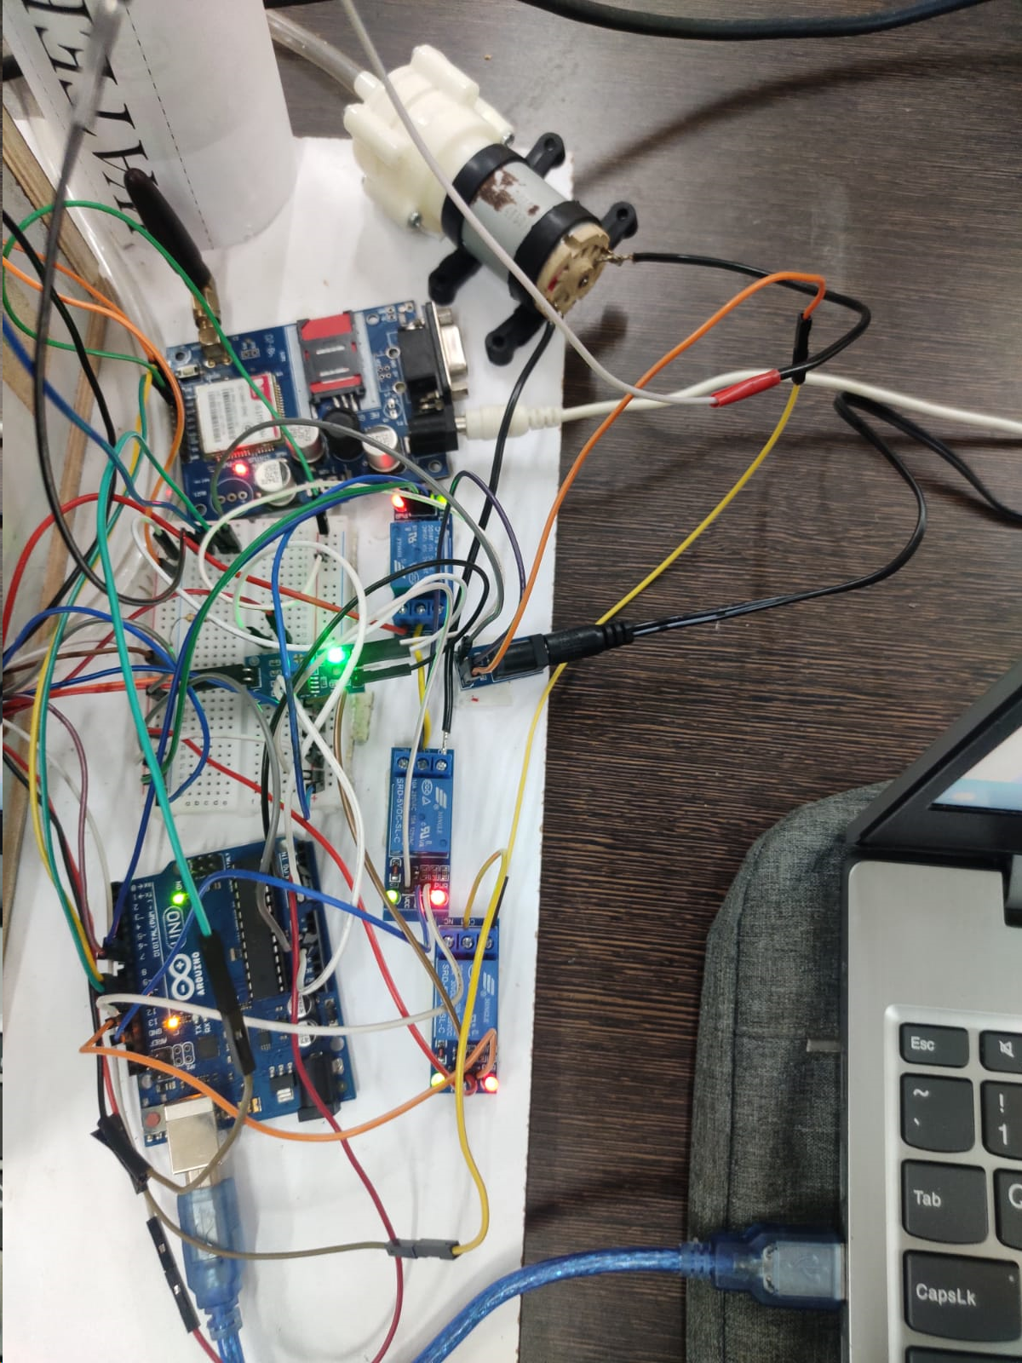
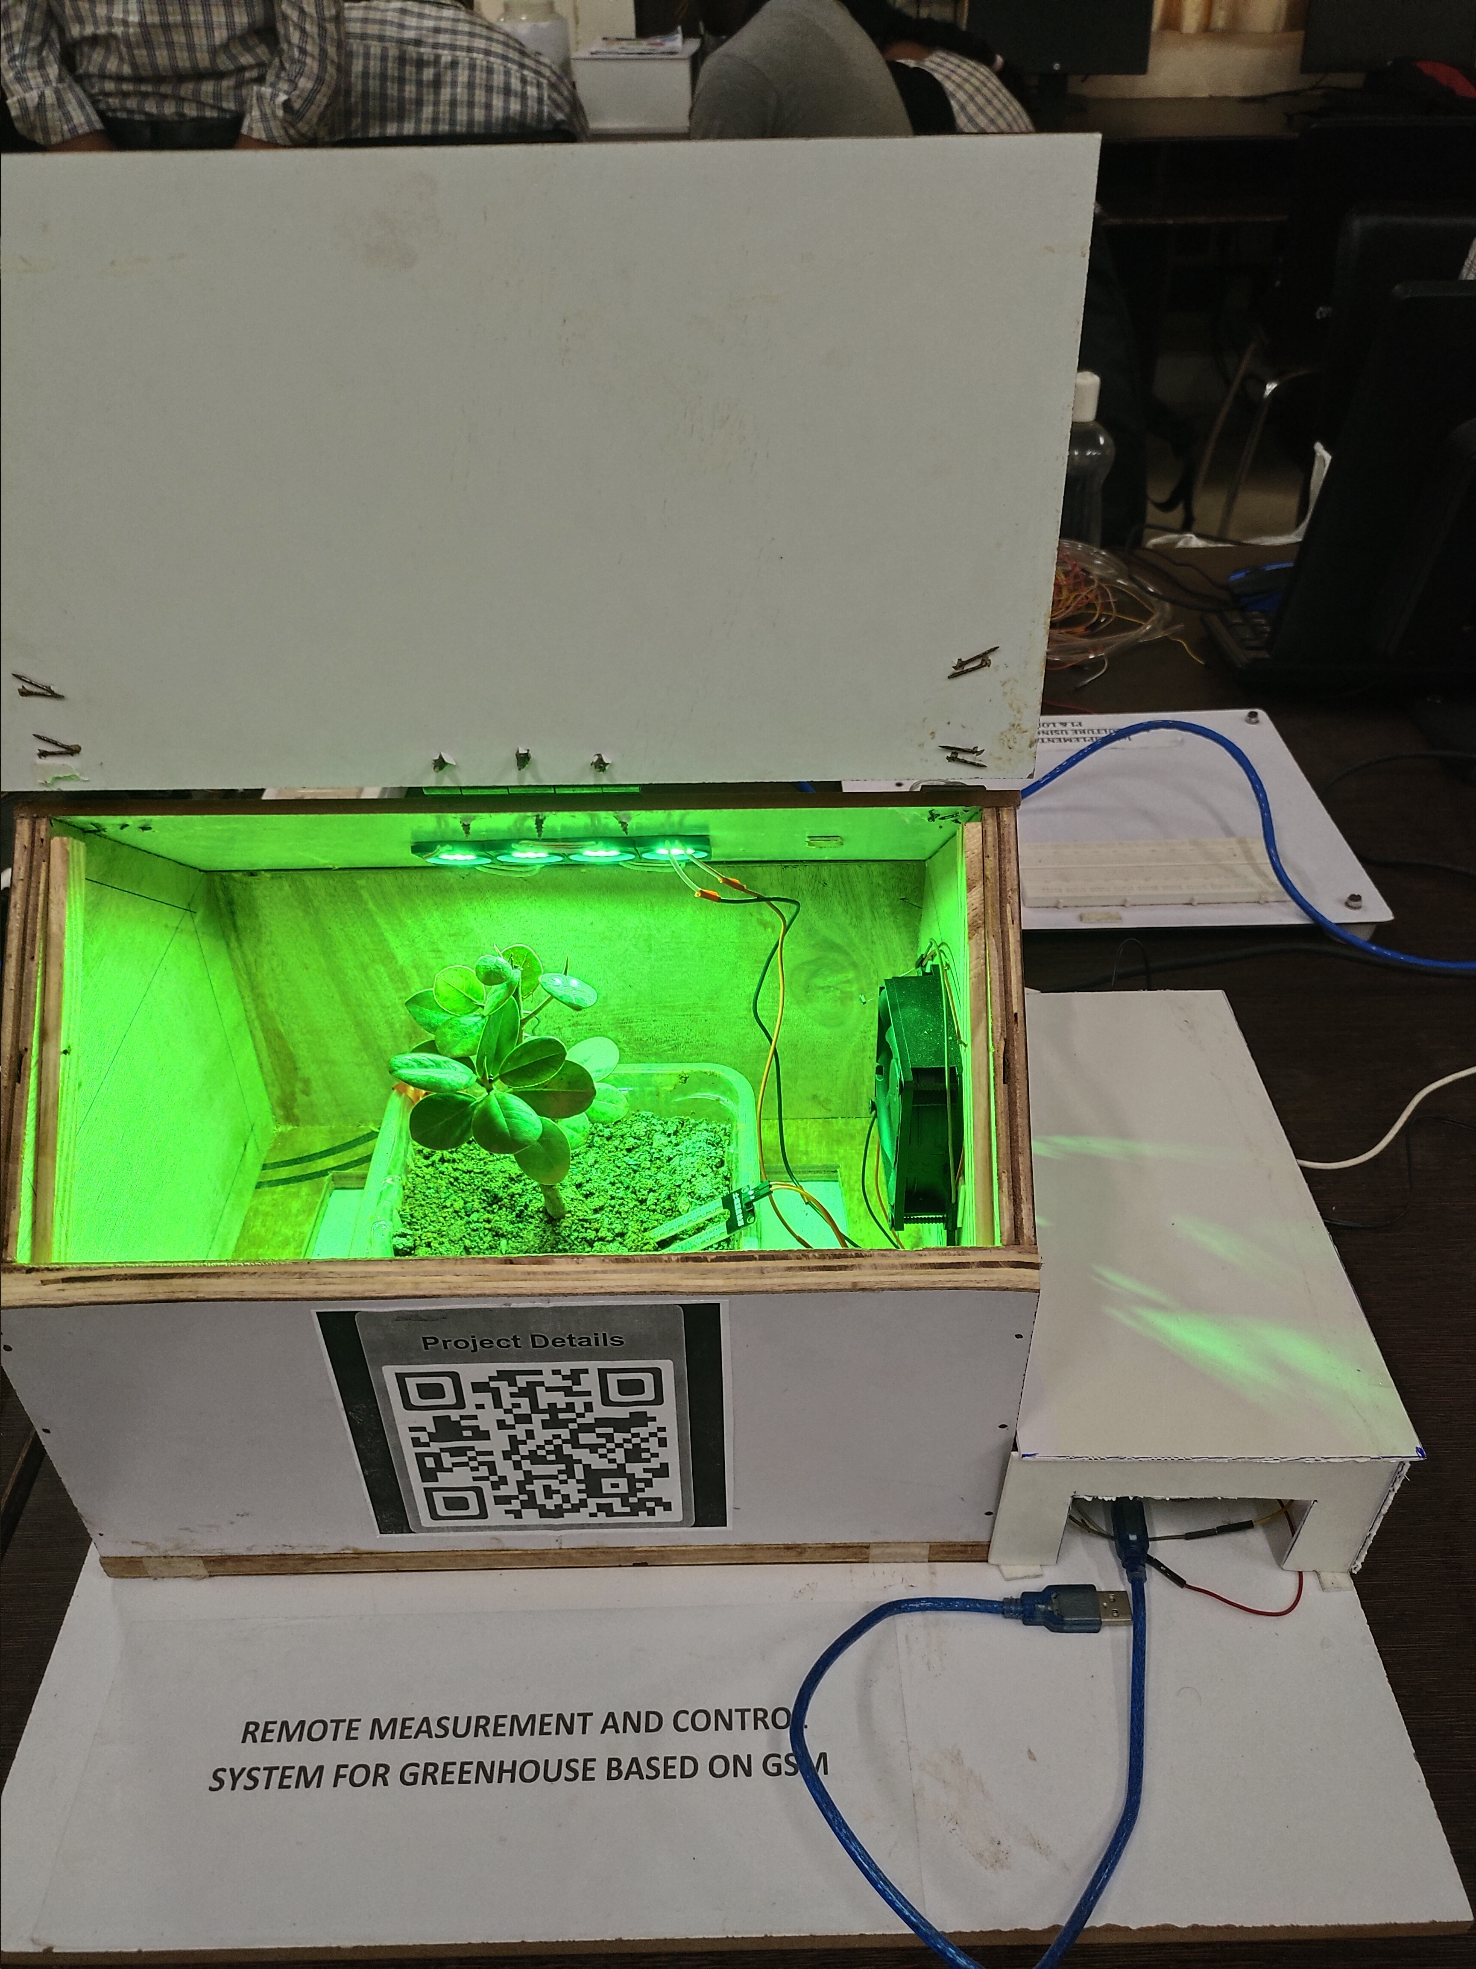
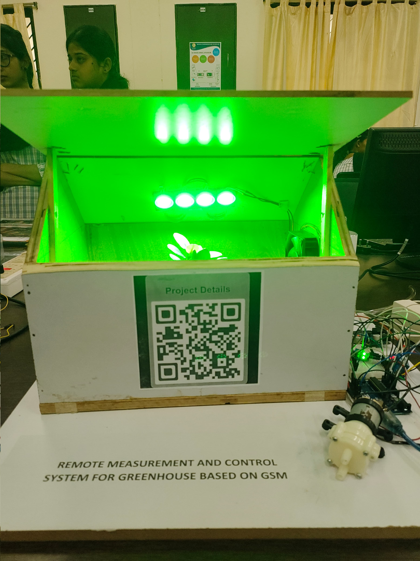
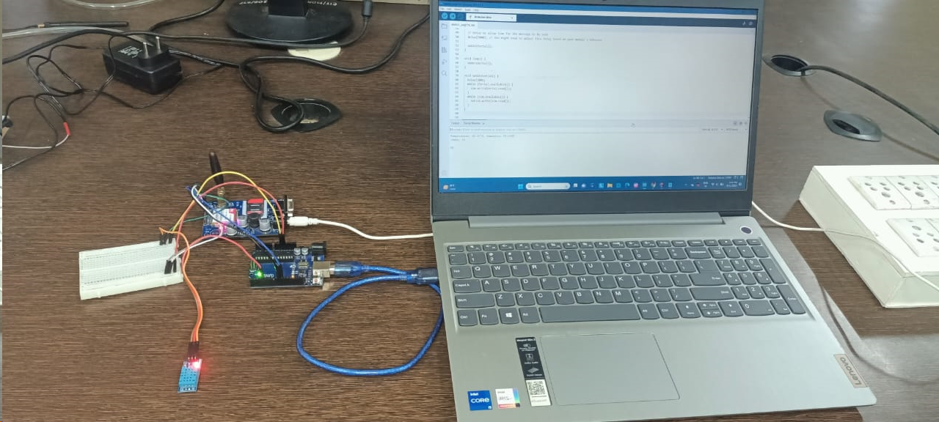
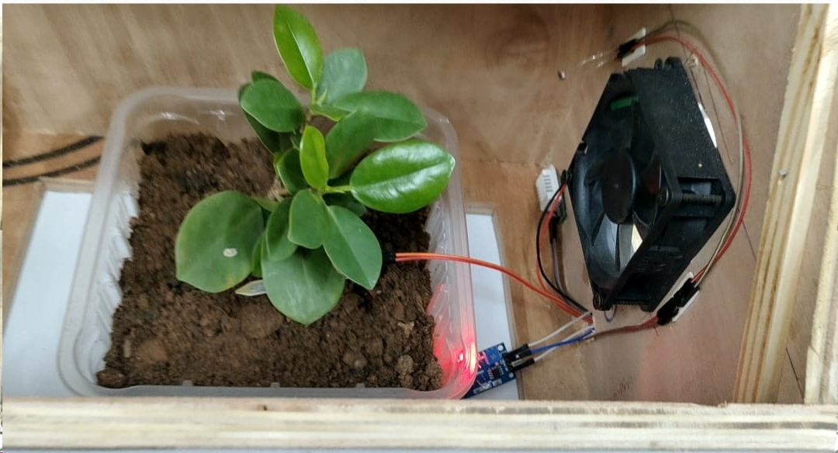
Real Implementation

Slide 8
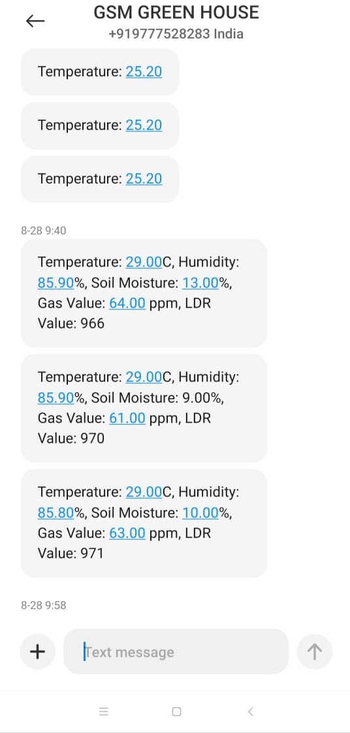
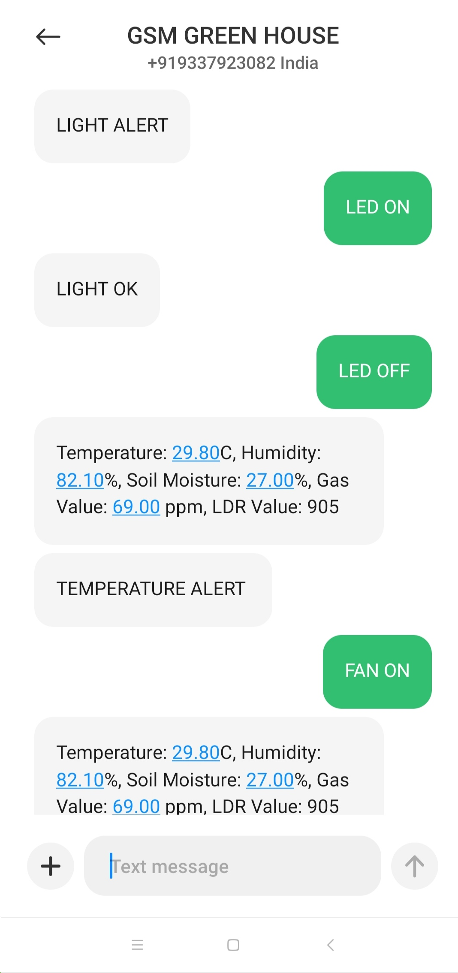
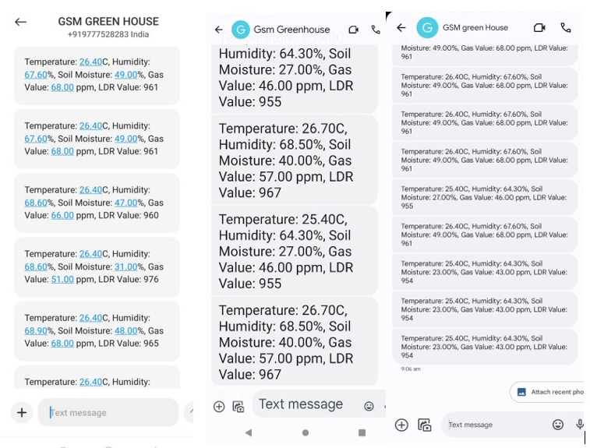
Results
SMS on single number
SMS on multiple number
SMS for control system

Slide 9
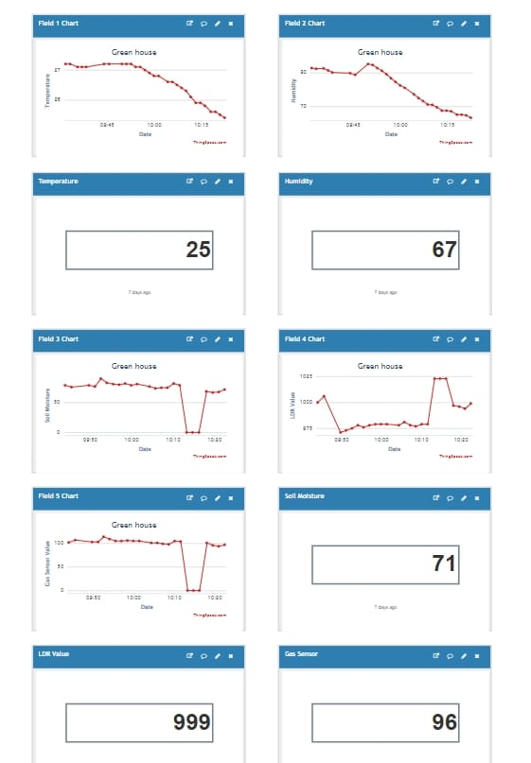
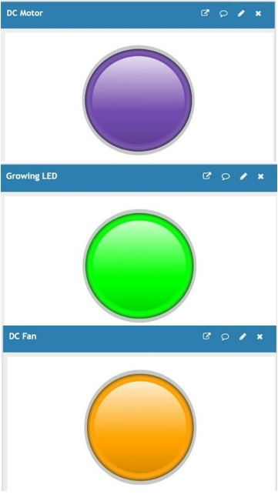
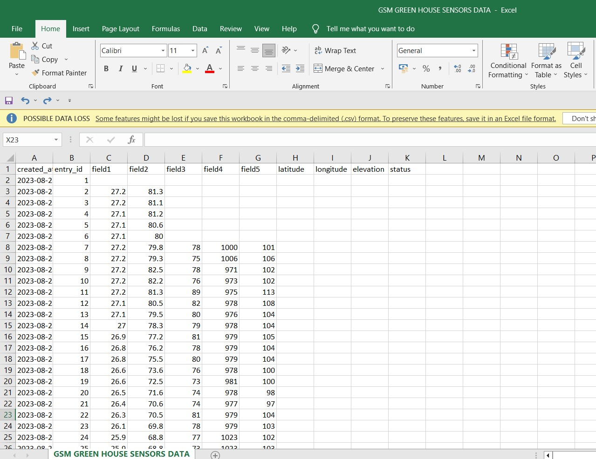
Visualization through ThingSpeak
Exporting data through CSV

Slide 10
Conclusion
This work has introduced an innovative remote measurement and control system for greenhouses using GSM technology and cellular communication.
An effective way of monitoring and managing greenhouse conditions is by combining SMS notifications, multi-number support, and ThingSpeak integration.
This system offers the agricultural sector a powerful tool for enhancing crop productivity, quality, and sustainability while reducing resource wastage and labor.
Implementing these features demonstrates the potential for advanced farming practices, ensuring that greenhouses remain good for optimal plant growth and contributing to a more efficient farming future.

Slide 11
Future Scope
Developing a mobile application will allow users to monitor and control the greenhouse directly from their smartphones.
To make the system more energy-efficient and sustainable, integrating solar panels to power sensors, actuators, and communication modules.
implementation of smart devices and sensors that can autonomously enter a low-power or sleep mode when not actively collecting or transmitting data.
Additionally, incorporating voice or email alerts alongside SMS notifications can offer users multiple communication options.

Slide 12
References
[1] Saidivya, Byrisetty, and Gurram Thirumalaiah, "Intelligent Greenhouse Monitoring and Automatic Controlling Protocol by Using Python on Raspberry Pi", In Modern Approaches in Machine Learning & Cognitive Science: A Walkthrough, pp. 533-546. Cham: Springer International Publishing, 2022.
[2] Kareem, O. S., and N. N. Qaqos, "Real-time implementation of greenhouse monitoring system based on wireless sensor network", International Journal of Recent Technology and Engineering (IJRTE) 8 (2019): 215-219.
[3] Gandhi, Vedant, Aditi Sardar, Paridhee Wani, Rakesh Borase, and Jayanand Gawande, "IOT Based Wireless Data Technology Using LORA and GSM", In ITM Web of Conferences, vol. 44, p. 01006. EDP Sciences, 2022.
[4] Cristea, Mario, Mihai Gabriel MATACHE, Claudia IONIŢĂ, Lucian Andrei PERIŞOARĂ, Robert Dorin CRISTEA, And Vlad Nicolae ARSENOAIA, "GSM WiFi MOBILE COMMUNICATION SYSTEM FOR AGRICULTURAL VEHICLES", INMATEH-Agricultural Engineering 67, no. 2, 2022.
[5] Chaudhari, Shilpa S., Dr Jayant J. Chopade, and Sushma M. Solanki. "Implementation of Iot in Agriculture Field Using Embedded System", In Proceedings of the 3rd International Conference on Contents, Computing & Communication (ICCCC-2022), 2022.

Slide 13
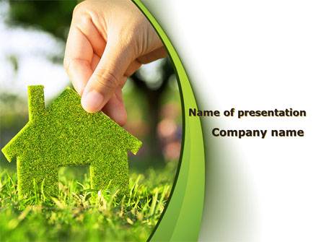
THANK YOU

